Slide 1

Exploratory Data Analysis
G2M Case Study
Virtual Internship
13-April-2022

Slide 2
Background and Agenda
XYZ is a private equity firm in US. Due to remarkable growth in the Cab Industry in last few years and multiple key players in the market, it is planning for an investment in Cab industry.
Objective : Provide actionable insights to help XYZ firm in identifying the right company for making investment.
The analysis has been divided into four parts:
Data Understanding
Forecasting profit and number of rides for each cab type
Finding the most profitable Cab company
Recommendations for investment

Slide 3
Data Exploration
24 Features( including 9 derived features)
Timeframe of the data: 2016-01-31 to 2018-12-31
Total data points : 355,032
Cab_Data.csv
Customer_ID.csv
Transaction_ID.csv
City.csv
Final cab data
The cab data contained the Transaction No, Customer ID and date that Transactions where carried out.
The Date had to be converted into a readable and understanding date.
Profit of rides are calculated keeping other factors constant and only (Price_Charged and Cost_of_Trip features used to calculate profit).

Slide 4
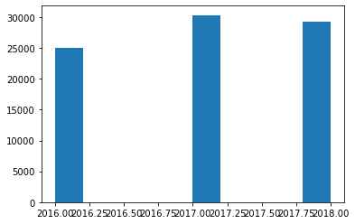
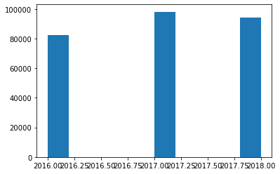
ANALYSIS OF PROFIT
TOTAL YEARLY PROFIT FOR THE PINK CAB
TOTAL YEARLY PROFIT FOR THE YELLOW CAB

Slide 5
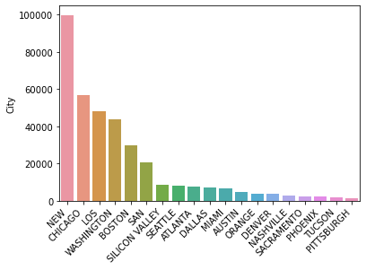
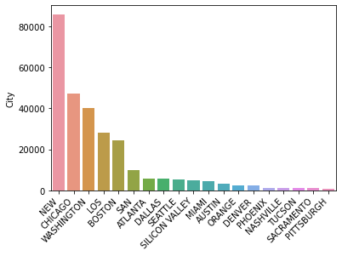
ANALYSIS
OF CAB
LOCATIONS
TOP STATES USING PINK CAB
TOP STATES USING YELLOW CAB

Slide 6
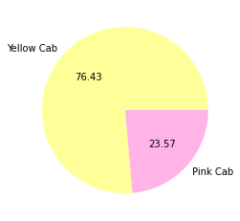
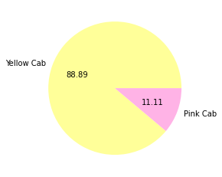
ANALYSIS OF TRANSACTIONS AND YEARLY PROFITS
TOTAL NUMBER OF TRANSACTIONS FROM 2016 - 2018
YEARLY PROFITS ALL TIME OF CABS

Slide 7

ANALYSIS OF TOTAL DISTANCE TRAVELLED
TOTAL DISTANCE TRAVELLED FROM 2016 - 2018
Clearly from the total Distance Travelled, we can clearly see that Customers Patronize the Yellow Cab more than the Pink Cab, Thus covering more distance for all three years combined.

Slide 8
Background and Agenda
We have evaluated both the cab companies on following points and found Yellow cab better than Pink cab:
• Customer Reach : Yellow cab has higher customer reach compared to the Pink cab. We have also observed that Yellow cab is doing good in covering other cab users as compared to Pink cab.
• Customer Retention: From the data we Analysed, we found that Yellow Cab has a better customer retention as compared to the Pink Cab.We also noticed some customers switching from the Pink cab to the Yellow cab.
• Average Profit per KM: Yellow cab’s average profit per KM is almost three times the average profit per KM of the Pink cab.
• Income wise Reach :Both the cabs are very popular in high and medium income class but here also Yellow cab is performing better than Pink cab in offering their services to all the three income class group (low, medium and high)
On the basis of above point , we will recommend Yellow cab for investment.

